Slide 1
Machine Drawing
DC Machine

Slide 2
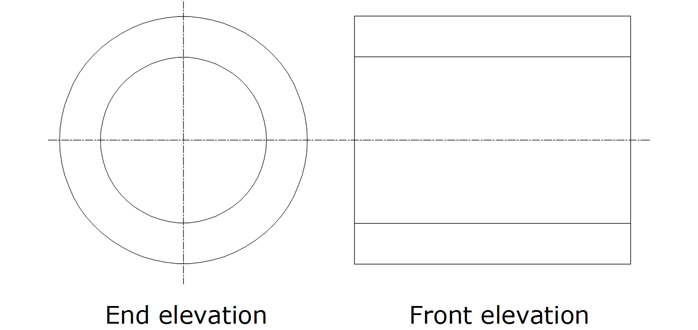
View
End elevation, longitudinal elevation, end sectional view: End view
Front elevation, side elevation: Side view

Slide 3
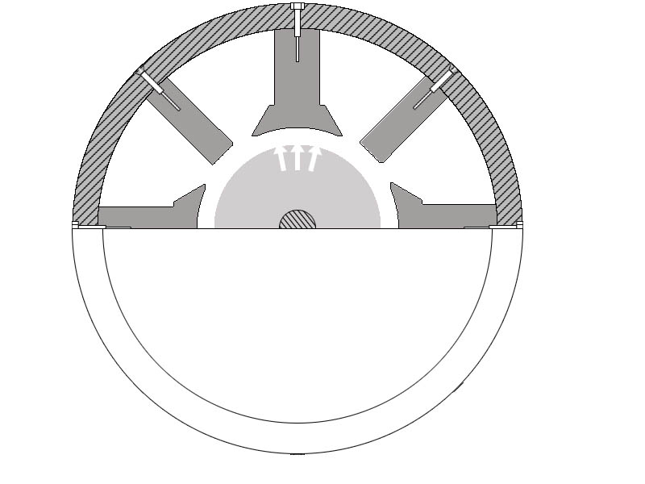
Sections
Half sectional view: Only one half, preferably top half in detail
Quarter sectional view: One-fourth of the machine in detail, rest covered
This is a half sectional end view.
Top half in detail, bottom half covered
by the machine cover, so the inner parts
are hidden

Slide 4
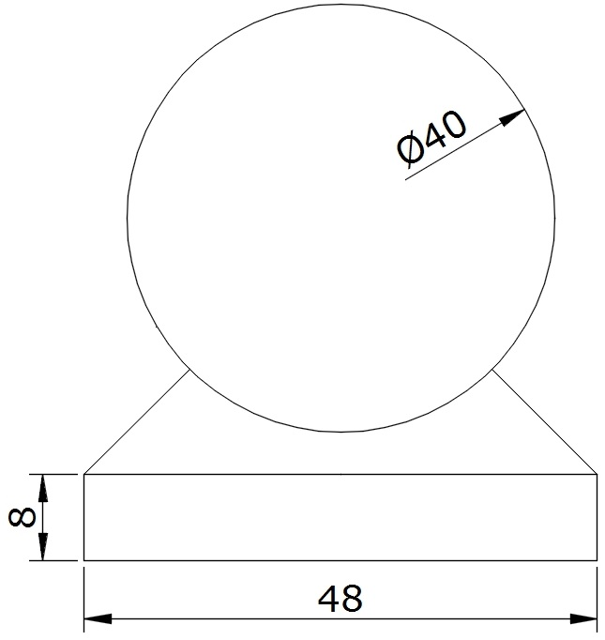
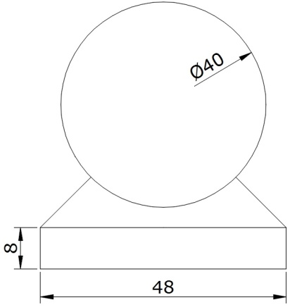
Scale
Scale: 1:2 - Half scale
The given dimensions are reduced by 2. A diameter of 24 cm becomes 12 cm while drawing
Scale: 1:4 - Quarter scale
The given dimensions are reduced by 4. A diameter of 24 cm becomes 6 cm while drawing
Scale: 1:1 - No change in the dimensions. The given values are used as given
Scale: 3:1 - The values given are trebled while drawing. Given dimension of 5 mm becomes 15 mm while drawing
Note: The given dimensions must
be mentioned in the drawing for any
scale, and not the scaled values
Actual size
Scale-1:2

Slide 5
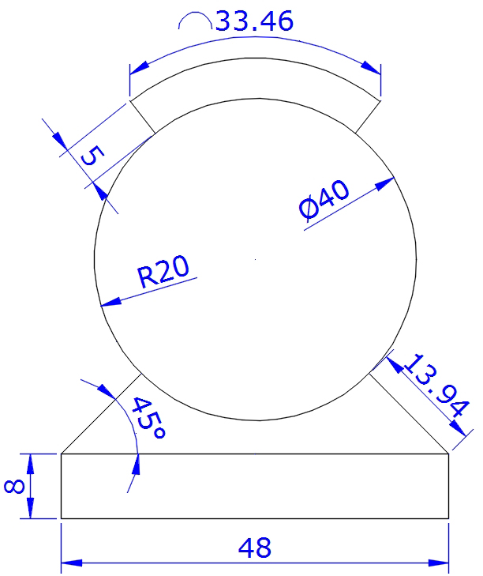
Dimensions
Dimensions are very important in machine assembly drawings
Radius mentioned as R20
Diameter as φ40
Here –
33.46 is arc length
45 is the angle in degrees
48 and 8 are linear dimensions
(for horizontal or vertical lines)
13.94 and 5 are aligned dimensions
(for tilted lines)
Note: The numbers must be aligned in the same direction as the arrows

Slide 6
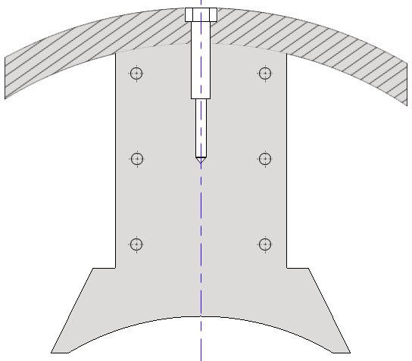
DC machine pole
A DC machine has a pole which is fixed to the yoke by bolts. The pole has a rectangular pole body and a curved pole shoe. Shoe ensures that the air gap is uniform by being parallel to the armature cylinder
Yoke
Bolt
Screws
Pole body
Pole shoe

Slide 7
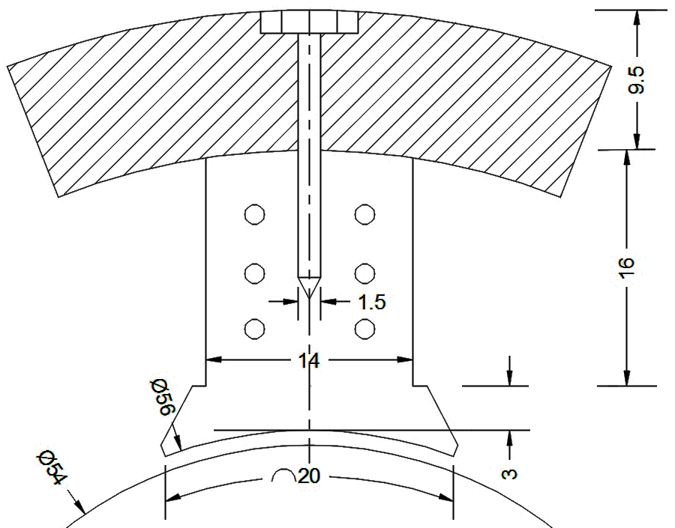
DC machine pole
Yoke height: 9.5
Pole width: 14
Pole height: 16
Shoe height: 3
Note: All heights, like pole body, pole shoe, yoke height are measured along the central axis
Bolt width: 1.5
Bolt height will not be mentioned. Bolt lengths will be approximately till the centre of the pole body
Pole body: The rectangular part of the pole
Pole shoe: The curved and extended potion of the pole

Slide 8
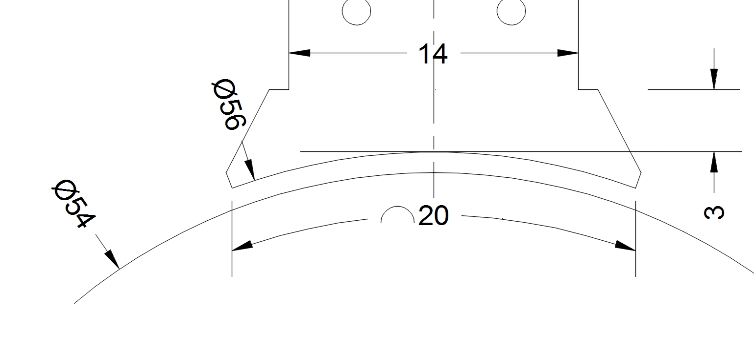
Calculating air gap
Given:
Pole arc diameter: 56 cm.
Therefore, pole arc radius is 56/2=28 cm
Armature diameter: 54 cm.
Therefore, armature radius is 54/2=27 cm
Air gap=pole arc radius-armature radius=28-27=1 cm

Slide 9
Measuring arc length
Given:
Pole arc length is 20 cm
Pole arc radius is 28 cm
A curved line like an arc cannot be measured directly using a scale. So the angle it subtends at its centre has to be calculated, to find the ends of the arc

Slide 10
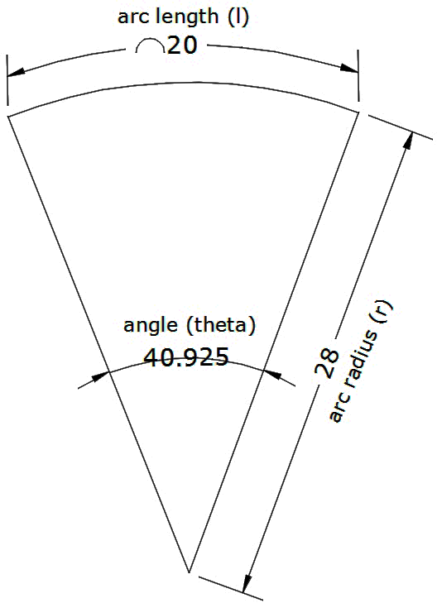

Measuring arc length
An arc of length 20 cm with radius 28 cm is required. A curved line like an arc cannot be measured directly using a scale. So the angle it subtends at its centre has to be calculated, to find the ends of the arc
Draw two line from centre with angle of 40.9º
The two points touching the arc mark the
ends of the arc, with length 20 cm

Slide 11
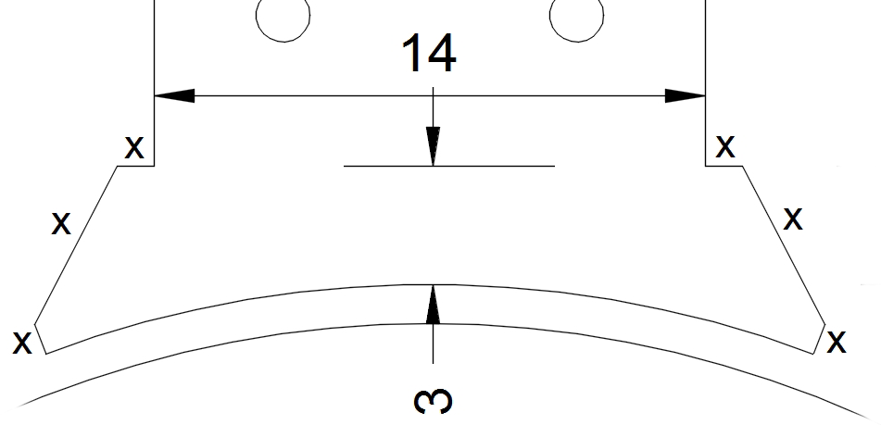
Pole shoe values
Pole shoe height is measured along the central axis.
The extension values of the pole shoe will usually not be given, marked by ‘x’ here. The ‘x’ values have to be assumed

Slide 12
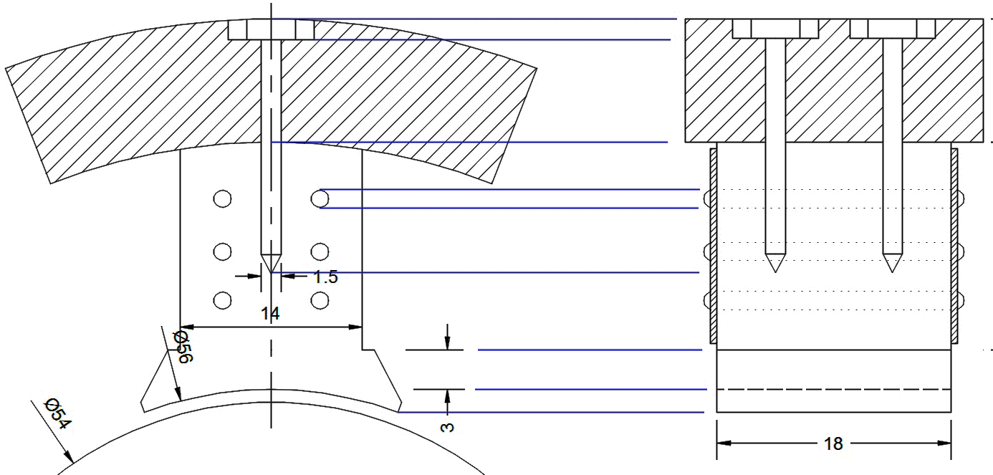
DC Pole side view
Side view is also called side elevation, front elevation
Draw a central axis. Through all lines crossing the central axis, draw horizontal lines
Draw rectangles with the length of the pole given
Draw extra parts like end plate, screws etc.
In end view, a single bolt can be seen. In side view, the bolts behind the front bolt are also seen

Slide 13
DC Machine Poles
A DC machine has poles fixed to the stator. The poles have windings to electro-magnetise them.
There are two types of poles
- main pole
- interpole

Slide 14
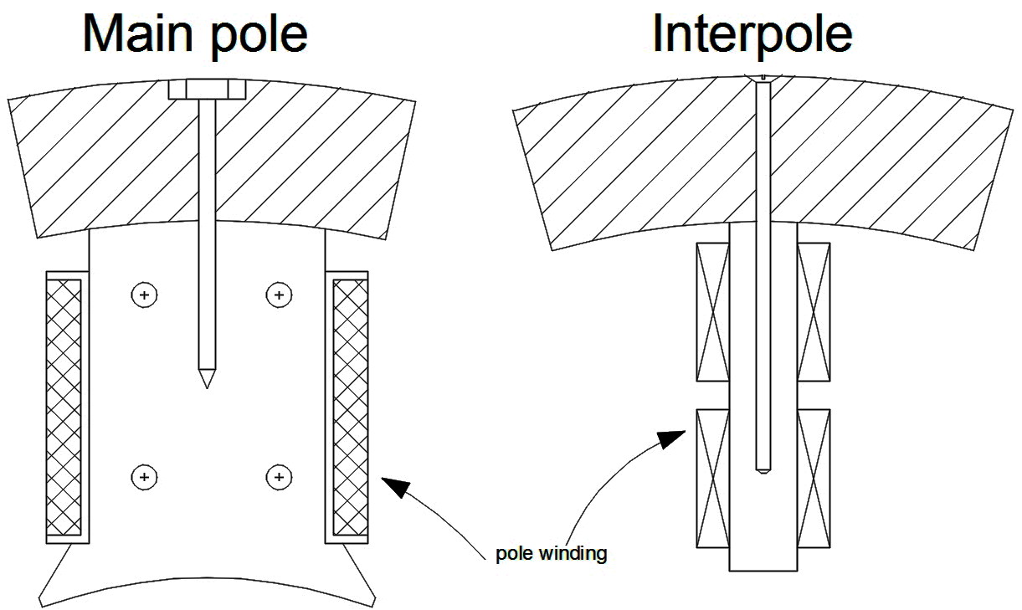
DC Machine Poles
Main pole is bigger, wider and has a pole shoe to make the air gap uniform
Interpole is placed between two main poles to compensate for the gap between them
Interpoles are thinner, so do not require pole shoe
Note the difference in pole windings and the bolts for both types of poles

Slide 15
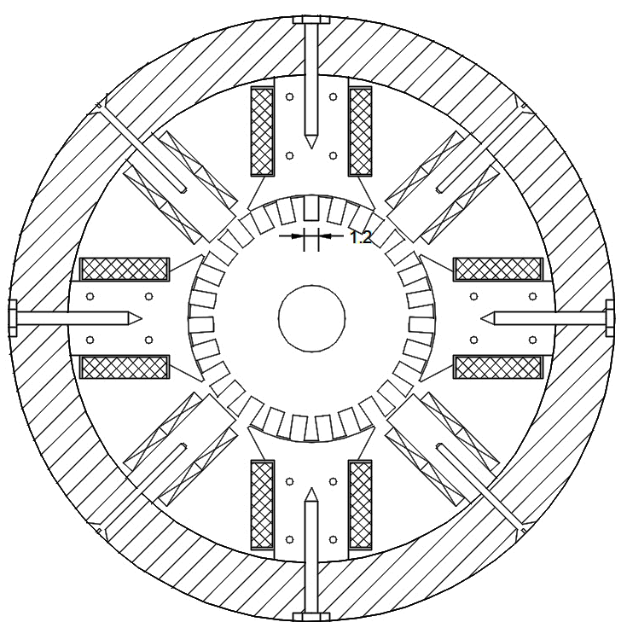
DC Machine
This is a DC machine
with 4 poles.
4 poles means there are
4 main poles and
4 interpoles
The circle has to be divided
into 8 sectors with angle
360/8=45º between them

Slide 16
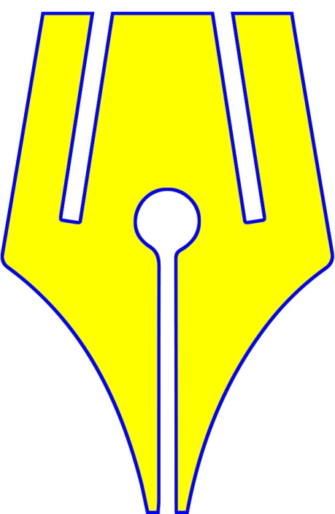
https://www.riteach.com

