Slide 1
AC Winding
Single Layer Mush (Basket) Winding

Slide 2
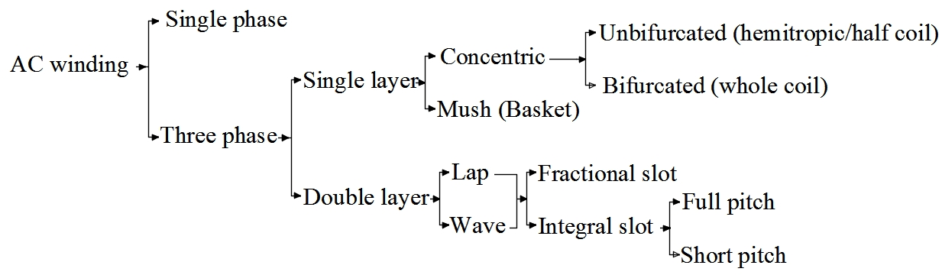
AC windings

Slide 3
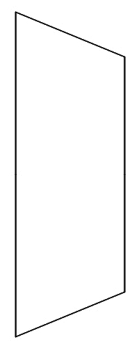
Mush (single layer) winding
It is also called Basket winding. All coils have the same span. Coil span can be 180º electrical, or less. Coil span must always be odd in number. Coil is shaped like a trapezium.

Slide 4
Draw developed single layer winding for a 24 slot, 4 pole AC machine
1. Slot pitch: slots/pole = 24/4 = 6
Normally coil span = slot pitch = 6. But coil span must be odd in mush windings
So, coil span = 6-1 = 5
2. slot angle = 180/slot pitch = 180/6 = 30º
Phase difference between adjacent slots is 30º
3. slot/pole/phase = 24/4/3 = 2
There are 2 Red, 2 Blue, 2 Yellow slots

Slide 5
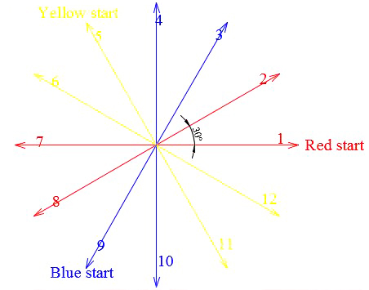
Assuming phase sequence to be RYB
Red starts from 1st slot Rs = 1+0/slot angle = 1+0/30 = 1
Yellow starts from 5th slot. Ys = 1+120/slot angle = 1+120/30=5
Blue starts from 9th slot Bs = 1+240/slot angle = 1+240/30=9

Slide 6
slot/pole/phase is 2, i.e., 2 Red, 2 Blue, 2 Yellow
Slot position table
1 | 2 | 3 | 4 | 5 | 6 | 7 | 8 | 9 | 10 | 11 | 12
R | R | B | B | Y | Y | R | R | B | B | Y | Y
13 | 14 | 15 | 16 | 17 | 18 | 19 | 20 | 21 | 22 | 23 | 24
R | R | B | B | Y | Y | R | R | B | B | Y | Y
Coil span is 5
1+5=6
1st Red must connect to 6th slot. This is a Yellow phase, so connection is not possible
Shift the entire set one slot left
1 | 2 | 3 | 4 | 5 | 6 | 7 | 8 | 9 | 10 | 11 | 12
R | B | B | Y | Y | R | R | B | B | Y | Y | R
13 | 14 | 15 | 16 | 17 | 18 | 19 | 20 | 21 | 22 | 23 | 24
R | B | B | Y | Y | R | R | B | B | Y | Y | R
1st Red can be connected to 6th slot which is also Red

Slide 7
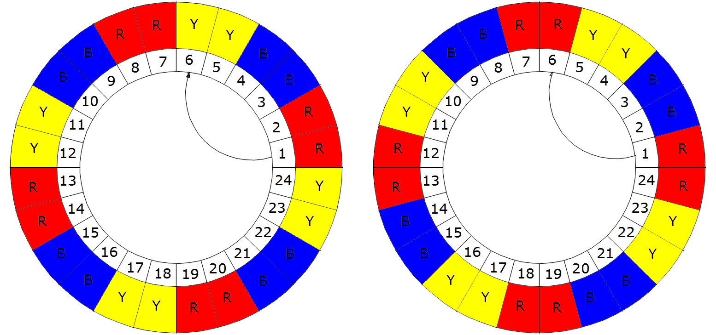
R1+coil span (5)=Y6
Not possible. Shift all left
R1+coil span (5)=R6

Slide 8
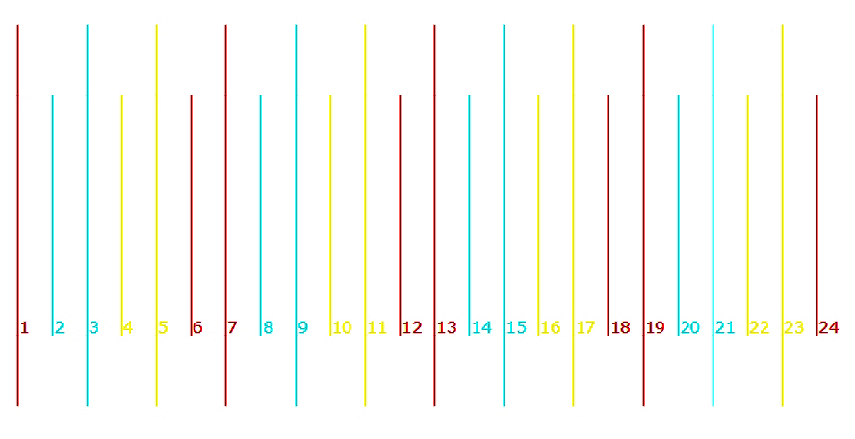
Winding diagram
1 | 2 | 3 | 4 | 5 | 6 | 7 | 8 | 9 | 10 | 11 | 12
R | B | B | Y | Y | R | R | B | B | Y | Y | R
13 | 14 | 15 | 16 | 17 | 18 | 19 | 20 | 21 | 22 | 23 | 24
R | B | B | Y | Y | R | R | B | B | Y | Y | R
Draw 24 lines according to the modified slot position table
All odd numbered lines are long
All even numbered lines are short

Slide 9
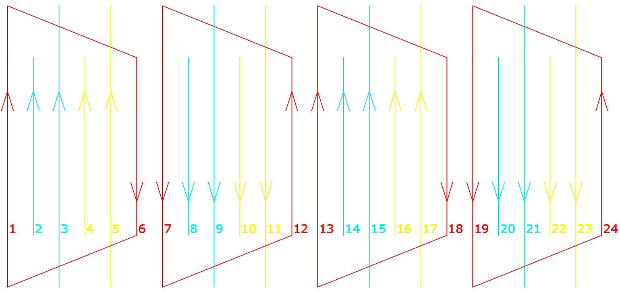
Winding diagram for Red phase
Connect long odd numbered lines to short even numbered lines

Slide 10
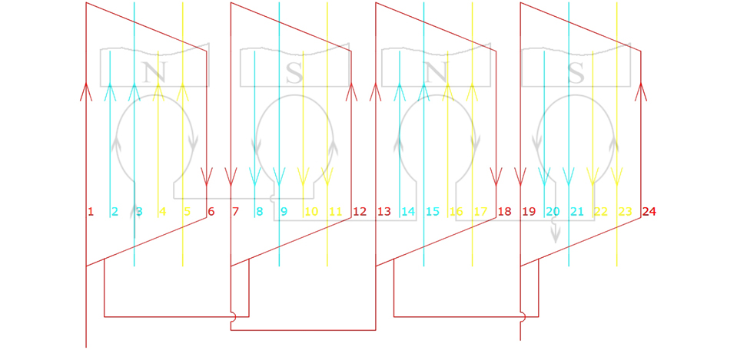
Winding diagram for Red phase
Coils under N pole have clockwise currents
Coils under S pole have anticlockwise currents

Slide 11
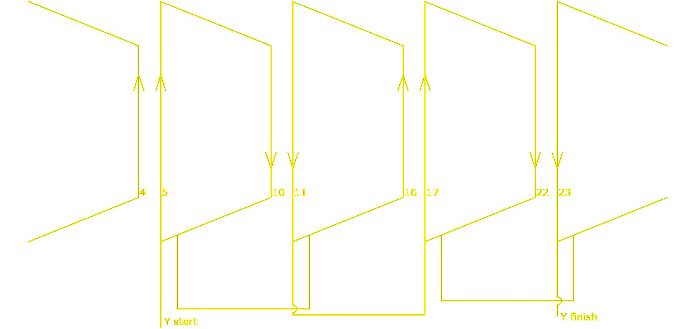
Winding diagram for Yellow phase

Slide 12
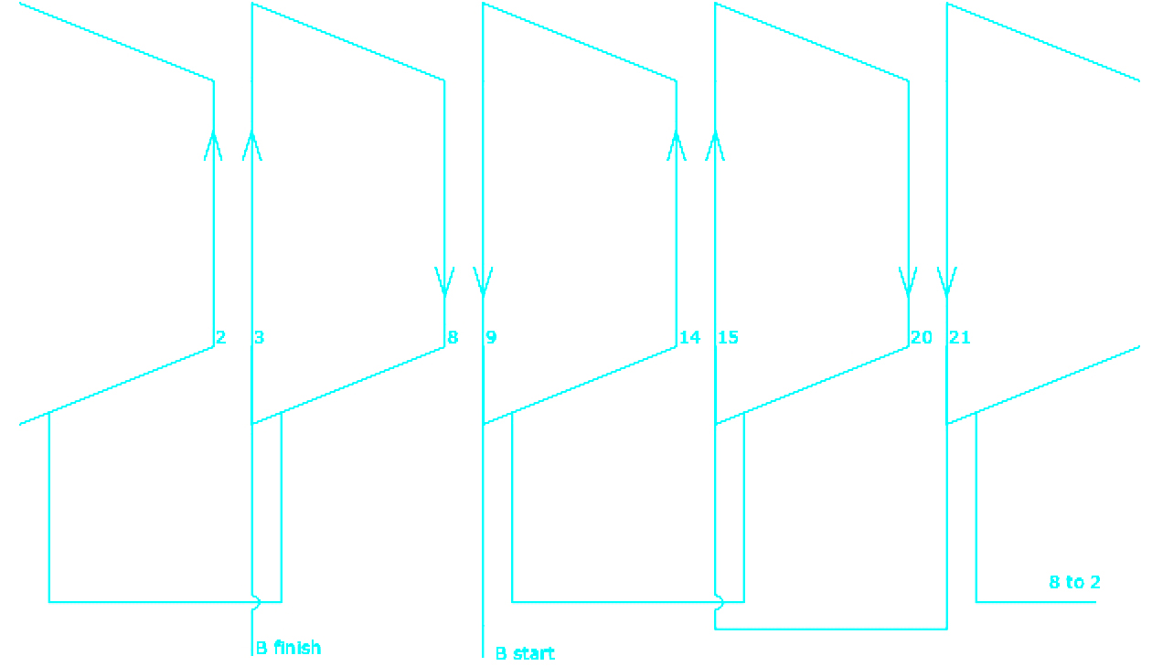
Winding diagram for Blue phase
Note that direction from Start to Finish and current direction are opposite
in Blue phase

Slide 13
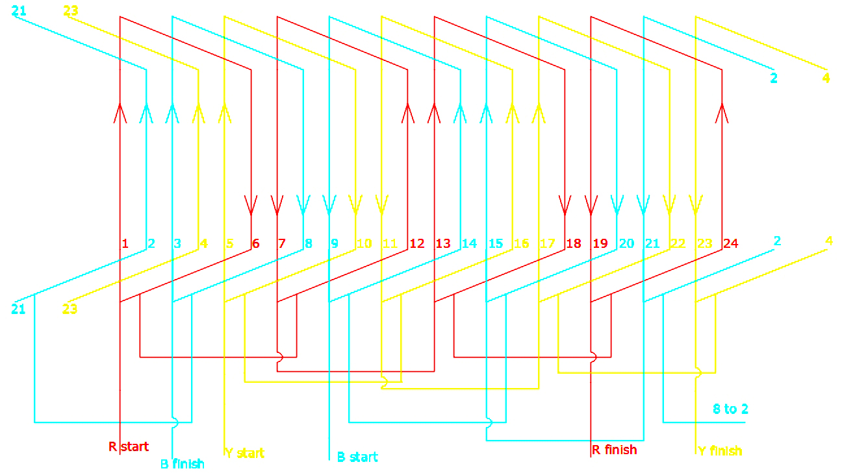
Completed winding diagram for all phases

Slide 14
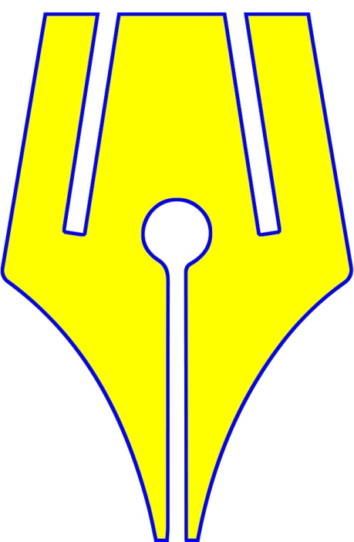
https://www.riteach.com

