Slide 1
AC Double Layer Winding
Short Pitch Lap

Slide 2
AC Double layer windings
In double layer windings for AC machines -
- all conductors are of equal height
- coil span can be even or odd
- full pitch has coil span=slot pitch (180º)
- short pitch has coil span=slot pitch-number of slots shorted (coil span < 180º)
- slots are numbered, not individual conductors

Slide 3
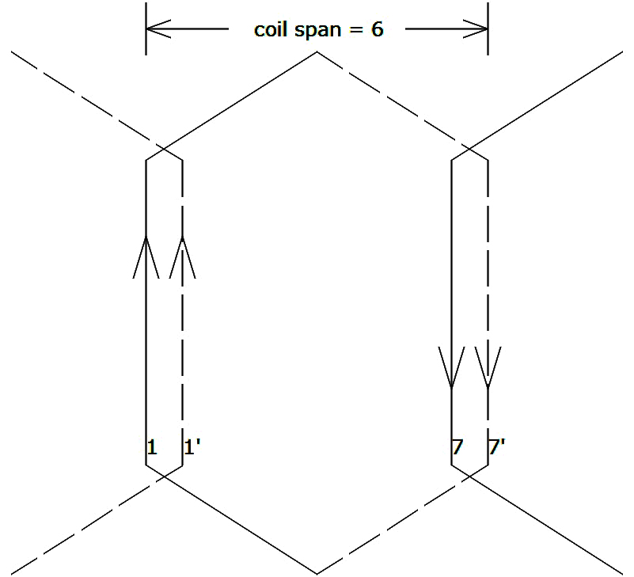
- coils are hexagonal in shape
- top conductor connects to bottom conductor
- top conductor drawn as solid line, tilts right
- bottom conductor drawn as dotted line, tilts left

Slide 4
Draw AC double layer winding with 24 slots and 2 poles, short pitched by 1 slot
slot pitch = slots/pole = 24/2 = 12
coil span = slot pitch-slots shorted =12-1 = 11
slot angle = 180/slot pitch = 180/12 = 15º
slot/pole/phase = 24/2/3 = 4

Slide 5
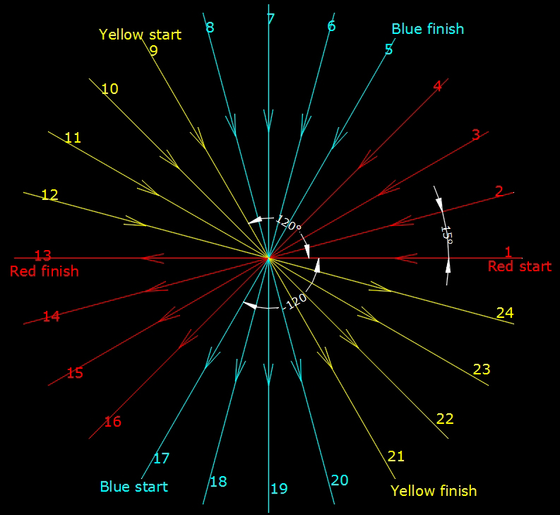
Assuming phase sequence to be RYB
Red starts from 1st slot Rs = 1+0/slot angle = 1+0/15 = 1
Yellow starts from 9th slot Ys = 1+120/slot angle = 1+120/15=9
Blue starts from 17th slot Bs = 1+240/slot angle = 1+240/30=17

Slide 6
Slot/pole/phase is 4, i.e., 4 Red, 4 Blue, 4 Yellow
Slots | 1 | 2 | 3 | 4 | 5 | 6 | 7 | 8 | 9 | 10 | 11 | 12
Top | R | R | R | R | B | B | B | B | Y | Y | Y | Y
Bottom | R’ | R’ | R’ | R’ | B’ | B’ | B’ | B’ | Y’ | Y’ | Y’ | Y’
Top conductor must be connect to bottom conductor
1+11=12 Top of 1st to connect to bottom of 12th
R1+coil span (11) = Y’12 which is not possible
Shift all conductors in bottom layer only left by one slot. 1st bottom Red will move to 24th bottom
Slots | 1 | 2 | 3 | 4 | 5 | 6 | 7 | 8 | 9 | 10 | 11 | 12
Top | R | R | R | R | B | B | B | B | Y | Y | Y | Y
Bottom | R’ | R’ | R’ | B’ | B’ | B’ | B’ | Y’ | Y’ | Y’ | Y’ | R’
Note: The above top and bottom pattern repeats for the next 12 slots also, from
13 to 24, so the full table need not be written

Slide 7
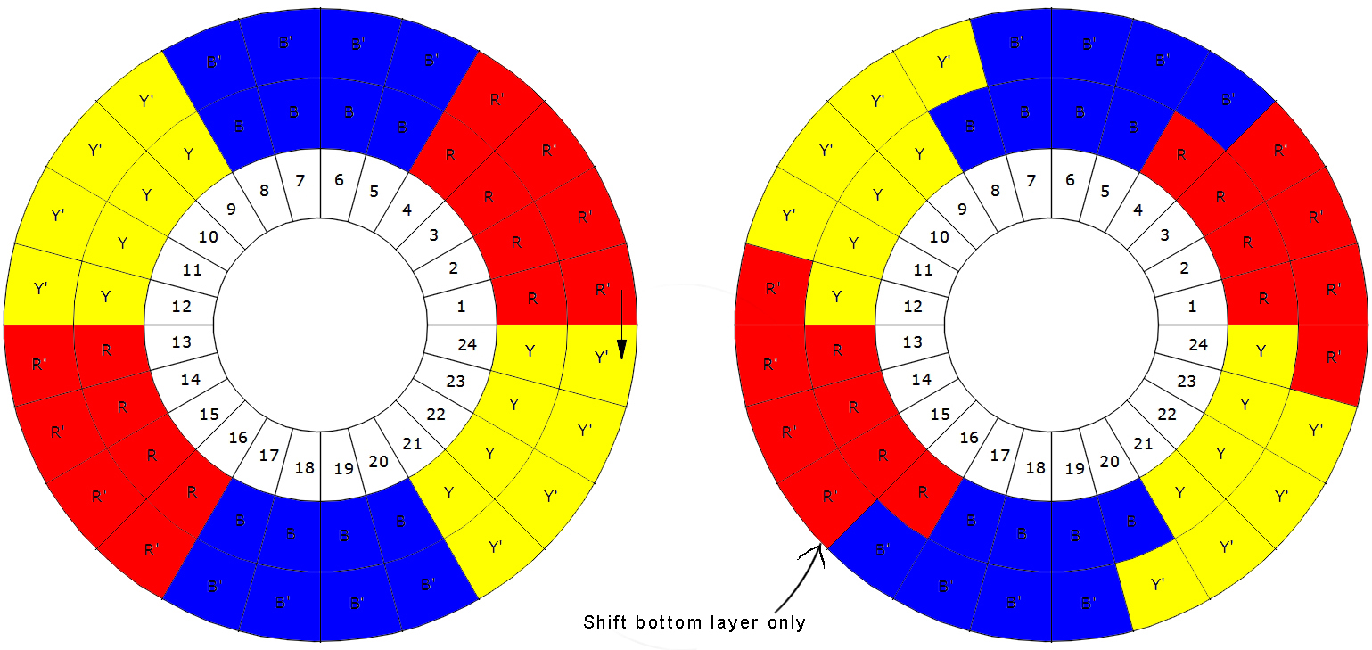
Once bottom is shifted left by 1 slot, R1+11=R’12

Slide 8
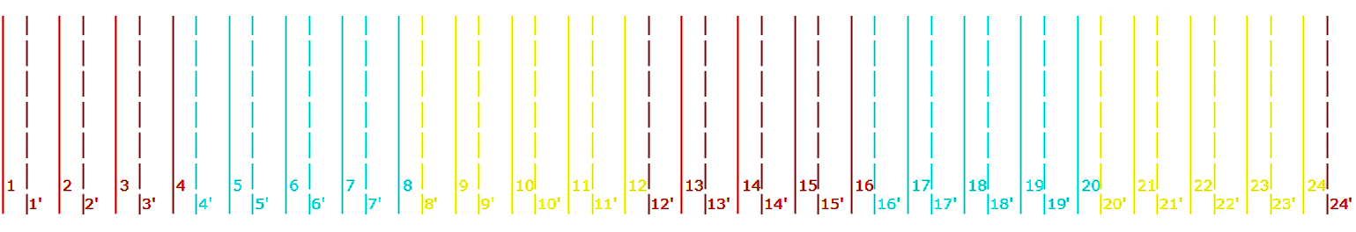
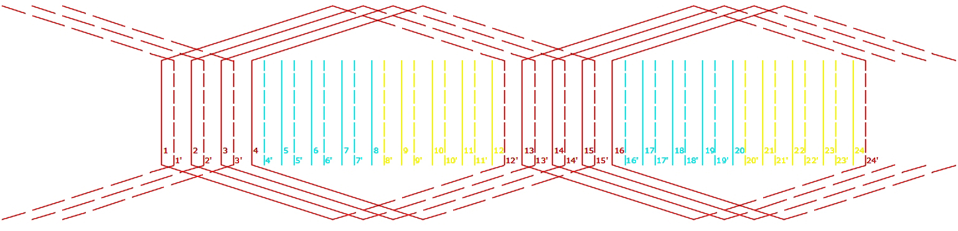
The complete slot distribution table:
 | 1 | 2 | 3 | 4 | 5 | 6 | 7 | 8 | 9 | 10 | 11 | 12 | 13 | 14 | 15 | 16 | 17 | 18 | 19 | 20 | 21 | 22 | 23 | 24
Top | R | R | R | R | B | B | B | B | Y | Y | Y | Y | R | R | R | R | B | B | B | B | Y | Y | Y | Y
Bot | R’ | R’ | R’ | B’ | B’ | B’ | B’ | Y’ | Y’ | Y’ | Y’ | R’ | R’ | R’ | R’ | B’ | B’ | B’ | B’ | Y’ | Y’ | Y’ | Y’ | R’
Draw 24 alternate solid and dotted lines, total 48 lines
Top of 1st Red connected to bottom (dotted line) of 12, that is, 12’
The same connection is repeated for bottom overhangs also, giving a hexagonal shape

Slide 9
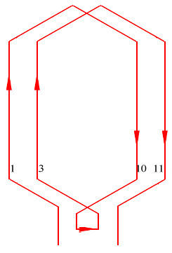
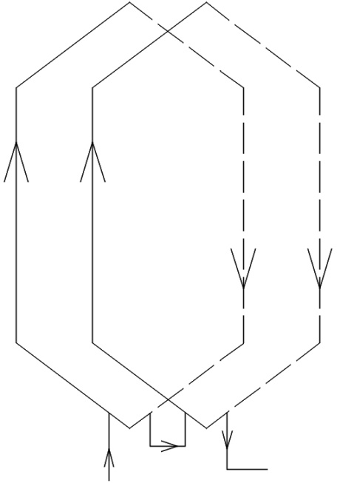
Note: When slot/pole/phase > 1, there will be more than 1 coil. Then the current direction and the coil connections are as below:
Current moves up one conductor, comes down another conductor (dotted line).
To join the next coil under the same pole,
a loop is formed and the current goes around the second coil before moving on to the next set of coils under the next pole.
If slot/pole/phase is 2, there will be 2 coils
under each pole, so 1 loop must be made.
If slot/pole/phase is 3, there will be 3 coils
under each pole, so 2 loops must be made.
Actual connection in a practical wiring

Slide 10
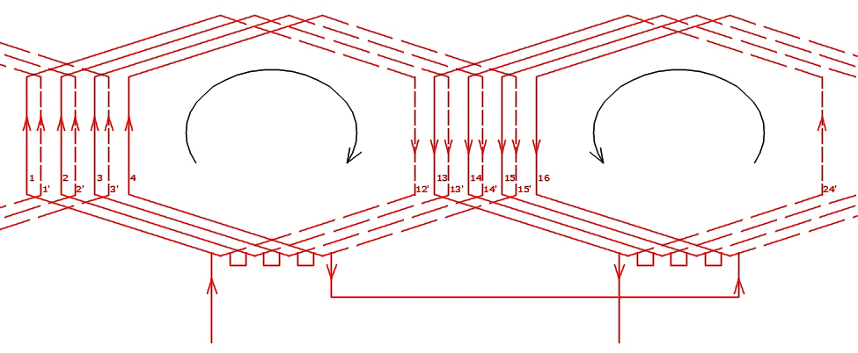
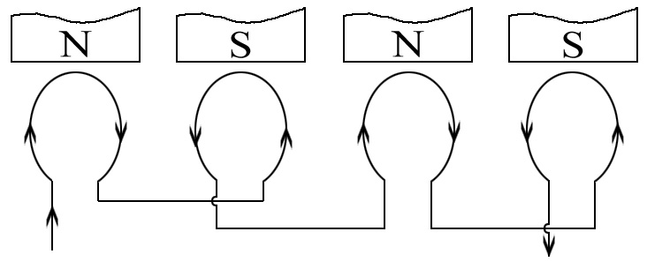
Current loop direction
under each pole.
Clockwise under N pole
Anticlockwise under S pole

Slide 11
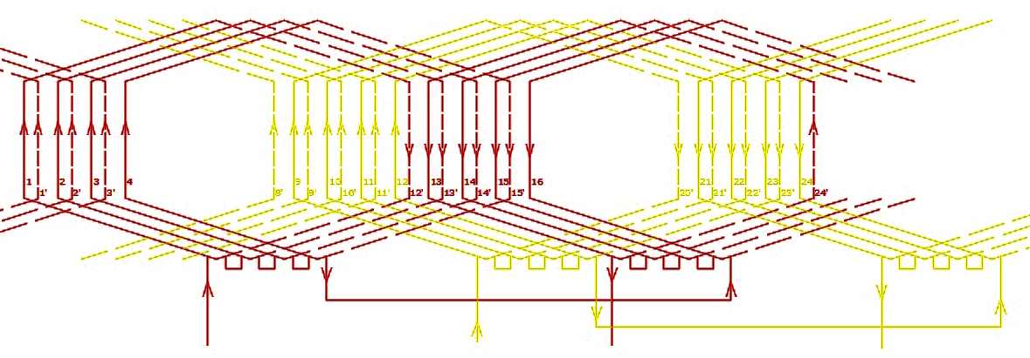
Repeat the connections for Yellow phase…

Slide 12
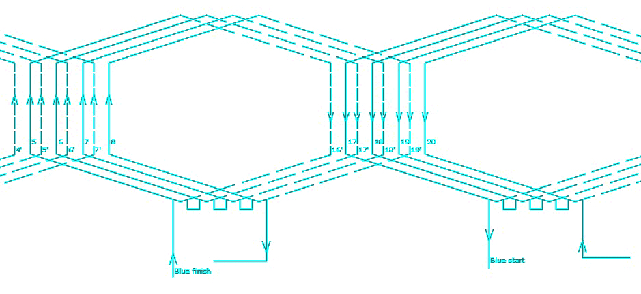
…and Blue phase
Note that for Blue phase, direction of Start-to-Finish and current direction are opposite

Slide 13
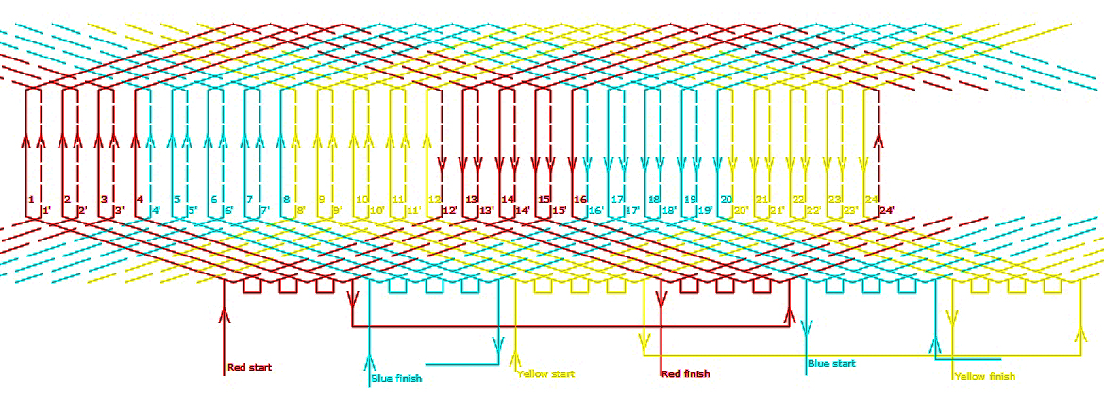
The complete winding diagram for all three phases
Last conductors for each phase can be found as:
Red starts from 1st slot 1+180/15=13 Red ends at 13th slot
Yellow starts from 9th slot 9+180/15=21 Yellow ends at 21st slot
Blue starts from 17th slot 17+180/15=29 29-24=5 Blue ends at 5th slot
Kuldeep S

Slide 14
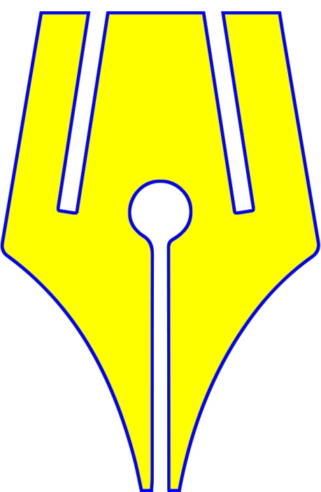
https://www.riteach.com

