Slide 1
AC Double Layer Winding
Fractional Slot
Kuldeep S

Slide 2
All fractional slot windings are short pitched. When
slot pitch and slot per pole per phase are not
integers, it is a fractional slot winding.
Advantages of fractional slot windings:
- Reduction of harmonic emfs and mmfs
- Reduction of design cost and material cost
- Reduction of leakage reactance of windings
- Reduction of copper in overhangs

Slide 3
Draw AC double layer winding with 33 slots and 4 poles
Calculations:
Slot pitch = slot/pole = 33/4 = 8.25
slot/pole/phase = 33/4/3 = 11/4 = 2 ¾
Slot angle = 180/slot pitch = 180/8.25 = 21.81º
Since slot pitch and slot/pole/phase are not integers, this is a fractional slot winding.
Slot distribution is not uniform like in integral slot windings.

Slide 4
Method to find slot distribution:
slot/pole/phase is 11/4 which means 11 has to be divided into 4 parts
This is first written as-
3 – 3 – 3 – 3
This comes to 12. Since 11 is required and not 12, 1 is reduced from the last 3
3 – 3 – 3 – 2 which becomes 11
-OR-
11/4 can be written as 2 – 2 – 2 – 2 which becomes 8. Since 11 is required, 3
must be added by adding 1 to first three numbers to make total as 11
2+1 - 2+1 - 2+1 – 2 -> 3 – 3 – 3 – 2
Note: If number has to be added, add to first numbers
If number has to be subtracted, minus from last numbers

Slide 5
Slot pattern is 3-3-3-2 totaling 11. Number of units is 1, given by P/d
P – number of poles
d – denominator in 11/4
P/d = 4/4 = 1. There is only one unit, or group, that is, the entire 33 slots
grouped in one single unit
Slot pattern for the whole unit (33 slots) is:
3 – 3 – 3 – 2 – 3 – 3 – 3 – 2 – 3 – 3 – 3 – 2
Divide this set into number of poles. 12 numbers divided into groups of 3 for
4 poles
Pole 1 (N1) | Pole 2 (S1) | Pole 3 (N2) | Pole 4 (S2)
3 – 3 – 3 | 2 – 3 – 3 | 3 – 2 – 3 | 3 – 3 – 2

Slide 6
This slot pattern is only for top layer in the double layer winding
For the bottom layer, shift the entire set right by one pole
Pole 1 (N1) | Pole 2 (S1) | Pole 3 (N2) | Pole 4 (S2)
3 – 3 – 3 | 2 – 3 – 3 | 3 – 2 – 3 | 3 – 3 – 2
 | Pole 1 (N1) | Pole 2 (S1) | Pole 3 (N2) | Pole 4 (S2)
Top | 3 – 3 – 3 | 2 – 3 – 3 | 3 – 2 – 3 | 3 – 3 – 2
Bot | 3 – 3 – 2 | 3 – 3 – 3 | 2 – 3 – 3 | 3 – 2 – 3
The complete table for top and bottom layers:
 | Pole 1 (N1) | Pole 2 (S1) | Pole 3 (N2) | Pole 4 (S2)
Top | 3 – 3 – 3 | 2 – 3 – 3 | 3 – 2 – 3 | 3 – 3 – 2
Bottom | 3 – 3 – 2 | 3 – 3 – 3 | 2 – 3 – 3 | 3 – 2 – 3

Slide 7
 | Pole 1 (N1) | Pole 2 (S1) | Pole 3 (N2) | Pole 4 (S2)
Top | 3 – 3 – 3 | 2 – 3 – 3 | 3 – 2 – 3 | 3 – 3 – 2
Bottom | 3 – 3 – 2 | 3 – 3 – 3 | 2 – 3 – 3 | 3 – 2 – 3
Table including the phases:
Poles | Pole 1 (N1) |  |  | Pole 2 (S1) |  |  | Pole 3 (N2) |  |  | Pole 4 (S2)
Phases | R | B | Y | R | B | Y | R | B | Y | R | B | Y
Top | 3 | 3 | 3 | 2 | 3 | 3 | 3 | 2 | 3 | 3 | 3 | 2
Bottom | 3 | 3 | 2 | 3 | 3 | 3 | 2 | 3 | 3 | 3 | 2 | 3

Slide 8
Poles | Pole 1 (N1) |  |  | Pole 2 (S1) |  |  | Pole 3 (N2) |  |  | Pole 4 (S2)
Phases | R | B | Y | R | B | Y | R | B | Y | R | B | Y
Top | 3 | 3 | 3 | 2 | 3 | 3 | 3 | 2 | 3 | 3 | 3 | 2
Bottom | 3 | 3 | 2 | 3 | 3 | 3 | 2 | 3 | 3 | 3 | 2 | 3
Top layer slot-pole distribution table:
 | Red | Blue | Yellow
Pole 1 (N1) | 1, 2, 3 | 4, 5, 6 | 7, 8, 9
Pole 2 (S1) | 10, 11 | 12, 13, 14 | 15, 16, 17
Pole 3 (N2) | 18, 19, 20 | 21, 22 | 23, 24, 25
Pole 4 (S2) | 26, 27, 28 | 29, 30, 31 | 32, 33
(3,3,3)
(2,3,3)
(3,2,3)
(3,3,2)
Bottom layer slot-pole distribution table:
 | Red | Blue | Yellow
Pole 1 (N1) | 1’, 2’, 3’ | 4’, 5’, 6’ | 7’, 8’
Pole 2 (S1) | 9’, 10’, 11’ | 12’, 13’, 14’ | 15’, 16’, 17’
Pole 3 (N2) | 18’, 19’ | 20’, 21’, 22’ | 23’, 24’, 25’
Pole 4 (S2) | 26’, 27’, 28’ | 29’, 30’ | 31’, 32’, 33’
(3,3,2)
(3,3,3)
(2,3,3)
(3,2,3)

Slide 9
Poles | Pole 1 (N1) |  |  | Pole 2 (S1) |  |  | Pole 3 (N2) |  |  | Pole 4 (S2)
Phases | R | B | Y | R | B | Y | R | B | Y | R | B | Y
Top | 3 | 3 | 3 | 2 | 3 | 3 | 3 | 2 | 3 | 3 | 3 | 2
Bottom | 3 | 3 | 2 | 3 | 3 | 3 | 2 | 3 | 3 | 3 | 2 | 3
Slot pattern for the entire set of 33 slots
 | 1 | 2 | 3 | 4 | 5 | 6 | 7 | 8 | 9 | 10 | 11 | 12 | 13 | 14 | 15 | 16 | 17 | 18 | 19 | 20 | 21 | 22 | 23 | 24 | 25 | 26 | 27 | 28 | 29 | 30 | 31 | 32 | 33
Top | R | R | R | B | B | B | Y | Y | Y | R | R | B | B | B | Y | Y | Y | R | R | R | B | B | Y | Y | Y | R | R | R | B | B | B | Y | Y
Bot | R’ | R’ | R’ | B’ | B’ | B’ | Y’ | Y’ | R’ | R’ | R’ | B’ | B’ | B’ | Y’ | Y’ | Y’ | R’ | R’ | B’ | B’ | B’ | Y’ | Y’ | Y’ | R’ | R’ | R’ | B’ | B’ | Y’ | Y’ | Y’
slot pitch = 8.25. Use the lower number 8 as the coil span
R1 + 8 = R’9

Slide 10
Starting slots for the phases:
slot angle = 180/8.25 = 21.81º
By default, Red starts from 1st slot
Yellow – 1+120/slot angle = 6.5 which is not an integer
Add 360 to 120. Since 360º ~ 0º, it is equivalent to adding 0 to 120
1+(120+360)/21.81 = 23 which is an integer. Yellow starts from 23rd slot
Blue – 1+240/slot angle = 12 which is an integer. Blue starts from 12th slot
Draw the winding diagram according to the slot distribution table
Bottom connections same as in integral slot winding connections

Slide 11
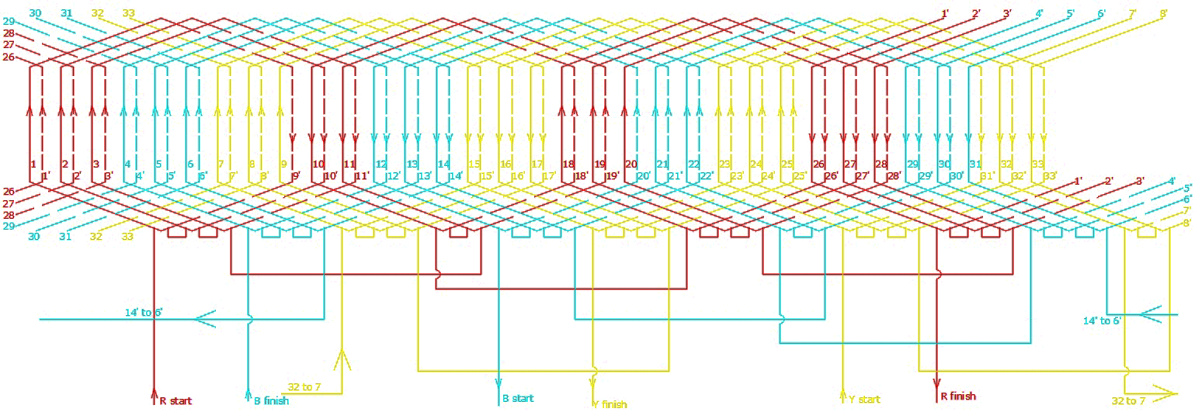
 | 1 | 2 | 3 | 4 | 5 | 6 | 7 | 8 | 9 | 10 | 11 | 12 | 13 | 14 | 15 | 16 | 17 | 18 | 19 | 20 | 21 | 22 | 23 | 24 | 25 | 26 | 27 | 28 | 29 | 30 | 31 | 32 | 33
Top | R | R | R | B | B | B | Y | Y | Y | R | R | B | B | B | Y | Y | Y | R | R | R | B | B | Y | Y | Y | R | R | R | B | B | B | Y | Y
Bot | R’ | R’ | R’ | B’ | B’ | B’ | Y’ | Y’ | R’ | R’ | R’ | B’ | B’ | B’ | Y’ | Y’ | Y’ | R’ | R’ | B’ | B’ | B’ | Y’ | Y’ | Y’ | R’ | R’ | R’ | B’ | B’ | Y’ | Y’ | Y’
Complete connection diagram

Slide 12
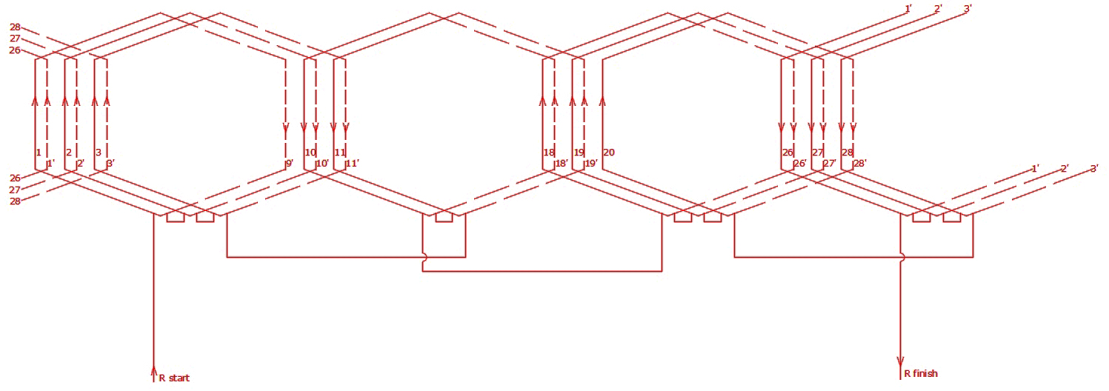
Red phase only

Slide 13
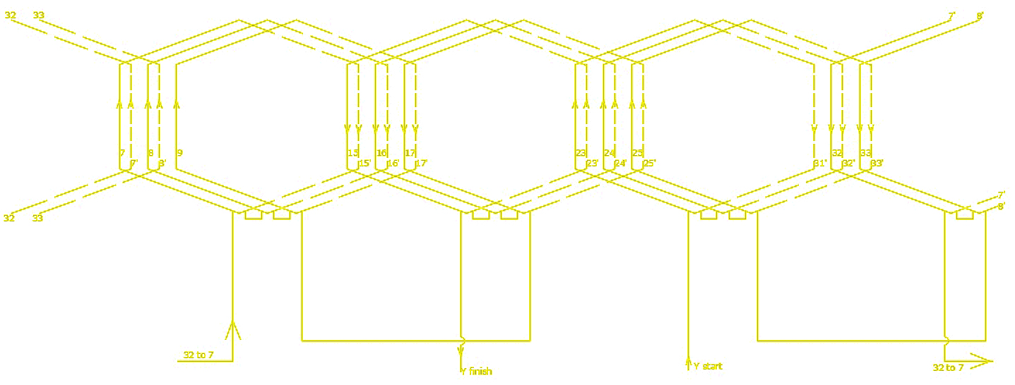
Yellow phase only

Slide 14
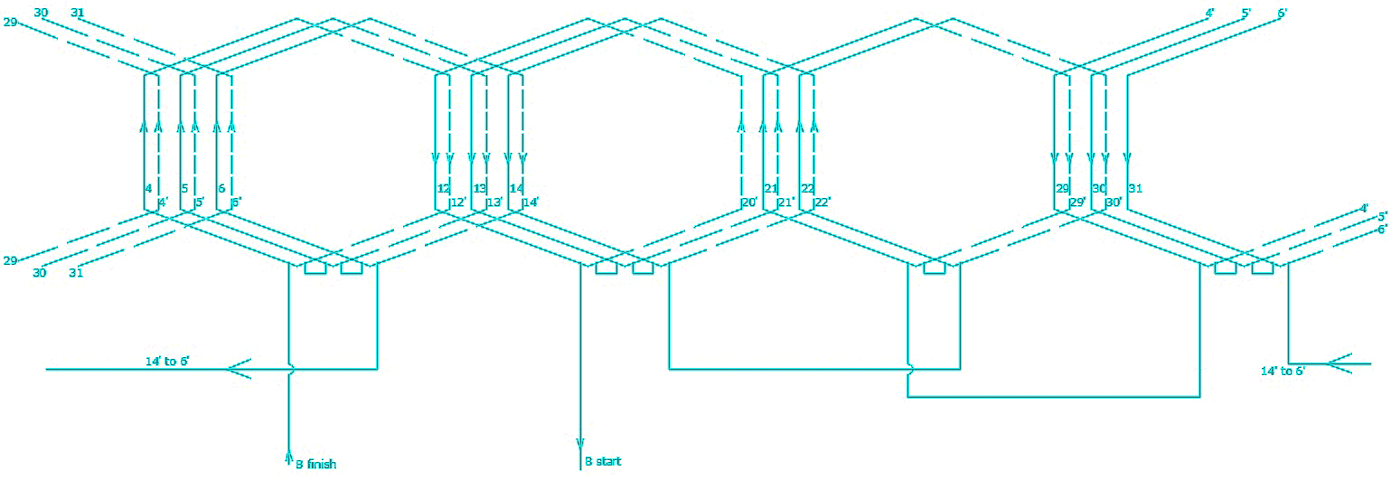
Blue phase only
kuldeeps10@yahoo.com

Slide 15
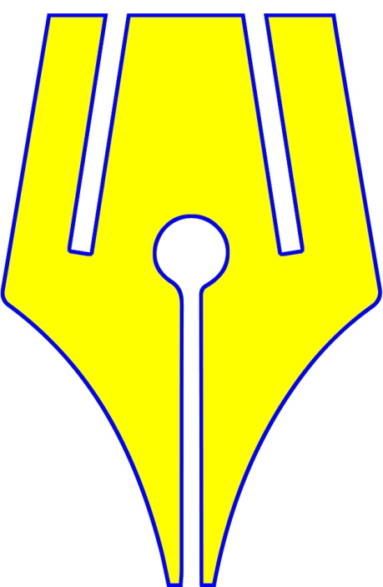
https://www.riteach.com

