Slide 1
AC Double Layer Winding
Wave Winding

Slide 2
Draw double layer AC wave winding with 12 slots and 4 poles
Slots/pole: 12/4 = 3
Slots/pole/phase: 12/4/3 = 1
Slot angle: 180/slot pitch = 180/3 = 60
Rs = 1
Ys = 1+120/slot angle = 3
Bs = 1+240/slot angle = 5

Slide 3
Slot pole table
 | Red | Blue | Yellow
Pole 1 – N | 1 | 2 | 3
Pole 2 – S | 4 | 5 | 6
Pole 3 – N | 7 | 8 | 9
Pole 4 – S | 10 | 11 | 12

Slide 4
Red slots are 1, 4, 7, 10. It is a double layer wave winding
To find the connections, one of the methods is –
Step 1:
1’
4’
7’
10 10’

Slide 5
Step 2: Repeat the last row and make the connections as below
1 1’
4 4’
7 7’
10 10’
1 1’
After 10’, it has to go to 1 which is not possible, so bottom of 10 connects to bottom of 1, i.e. 1’ and then goes back in reverse direction from right to left
Winding is: 1 – 4’ – 7 – 10’ – 1’ – 10 – 7’ - 4

Slide 6
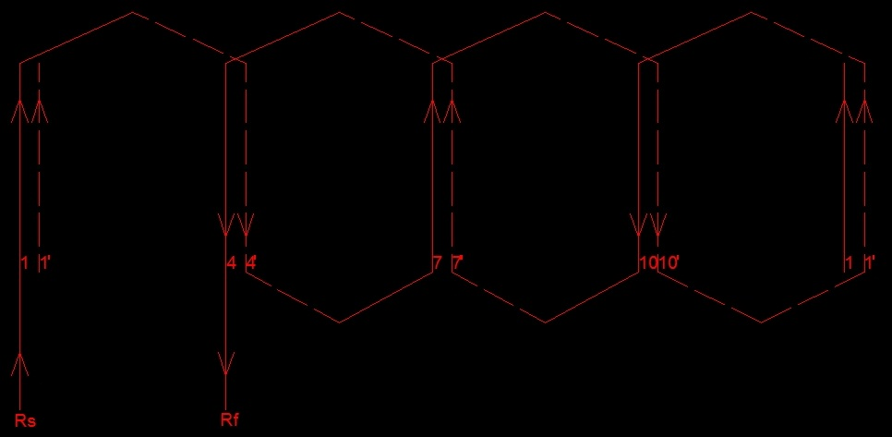
Red connections 1 – 4’ – 7 – 10’ – 1’ – 10 – 7’ - 4

Slide 7
Blue slots are 5, 8, 11, 2
To find the connections –
Step 1:
5 5’
8 8’
11 11’
2 2’

Slide 8
Step 2: Repeat the last row and make the connections as below
5 5’
8 8’
11 11’
2 2’
5 5’
After 2’, it has to go to 5 which is not possible, so bottom of 2 connects to bottom of 5, i.e. 5’ and then goes back in reverse direction from right to left
Winding is: 5 – 8’ – 11 – 2’ – 5’ – 2 – 11’ - 8

Slide 9
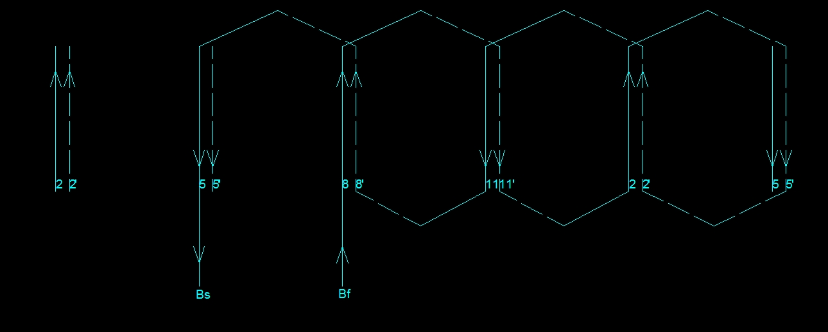
Blue connections 5 – 8’ – 11 – 2’ – 5’ – 2 – 11’ - 8

Slide 10
Yellow slots connected as-
3 3’
6 6’
9 9’
12 12’
3 3’
After 12’, it has to go to 3 which is not possible, so bottom of 12 connects to bottom of 3, i.e. 3’ and then goes back in reverse direction from right to left
Winding is: 3 – 6’ – 9 – 12’ – 3’ – 12 – 9’ - 6

Slide 11
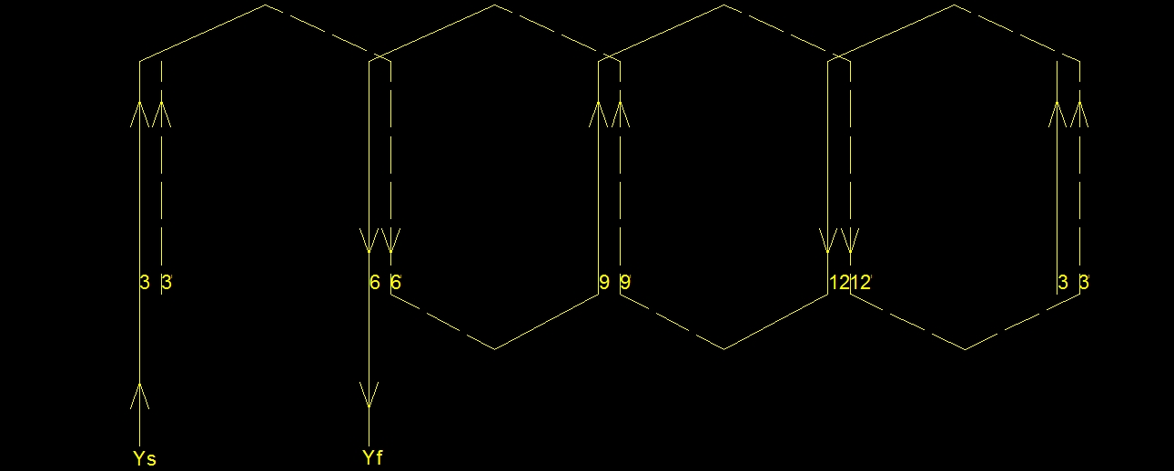
Yellow connections 3 – 6’ – 9 – 12’ – 3’ – 12 – 9’ - 6

Slide 12
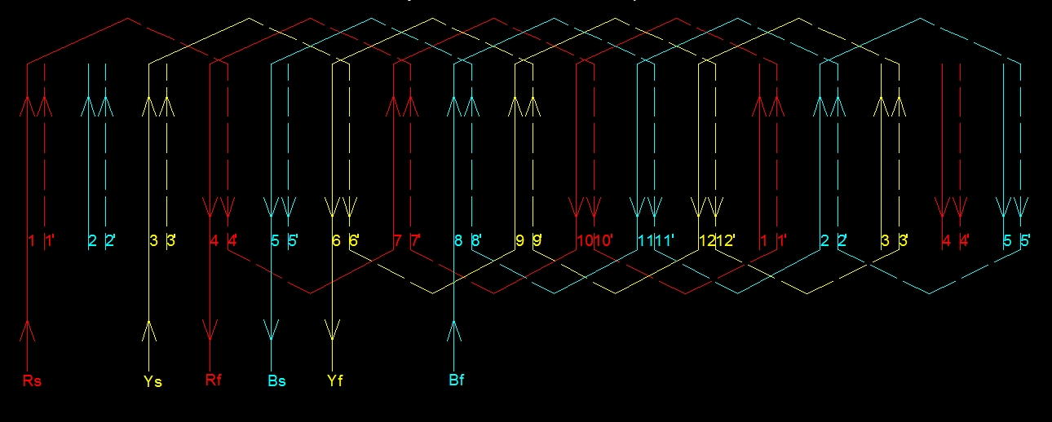
Complete winding

Slide 13
Draw double layer wave winding for 18 slots and 2 poles
Slot pitch: 18/2 = 9
Slots/pole/phase: 18/2/3 = 3
Slot angle: 180/9 = 20
Rs = 1
Ys = 1+120/20 = 7
Bs = 1+240/20 = 13

Slide 14
Slot pole table
Red
 | Red | Blue | Yellow
Pole 1 – N | 1 2 3 | 4 5 6 | 7 8 9
Pole 2 – S | 10 11 12 | 13 14 15 | 16 17 18
1 | 1’
10 | 10’ | 2 | 2’
1 | 1’ | 11 | 11’ | 3 | 3’
 |  | 2 | 2’ | 12 | 12’
 |  |  |  | 3 | 3’

Slide 15
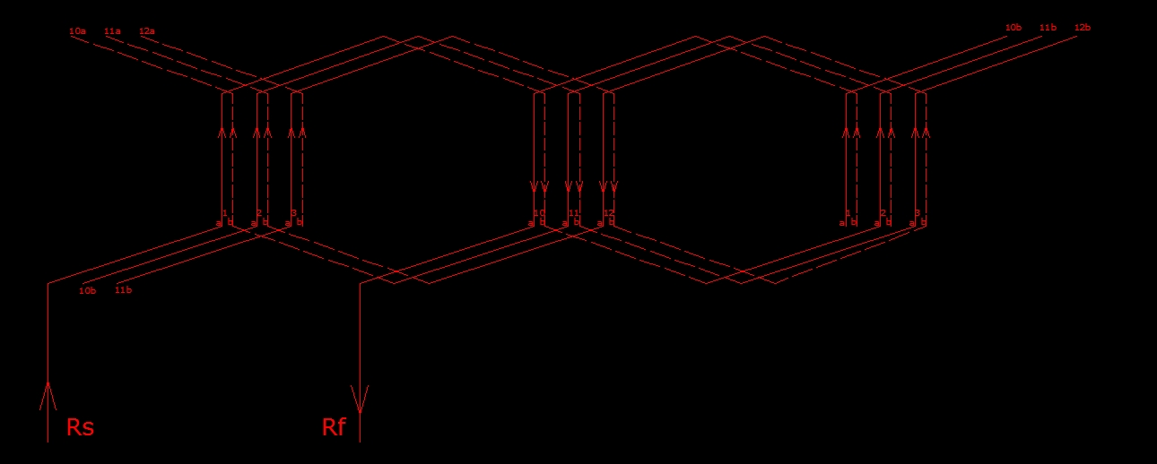
1 | 1’
10 | 10’ | 2 | 2’
1 | 1’ | 11 | 11’ | 3 | 3’
 |  | 2 | 2’ | 12 | 12’
 |  |  |  | 3 | 3’

Slide 16
Slot pole table
Blue
 | Red | Blue | Yellow
Pole 1 – N | 1 2 3 | 4 5 6 | 7 8 9
Pole 2 – S | 10 11 12 | 13 14 15 | 16 17 18
13 | 13’
4 | 4’ | 14 | 14’
13 | 13’ | 5 | 5’ | 15 | 15’
 |  | 14 | 14’ | 6 | 6’
 |  |  |  | 15 | 15’

Slide 17
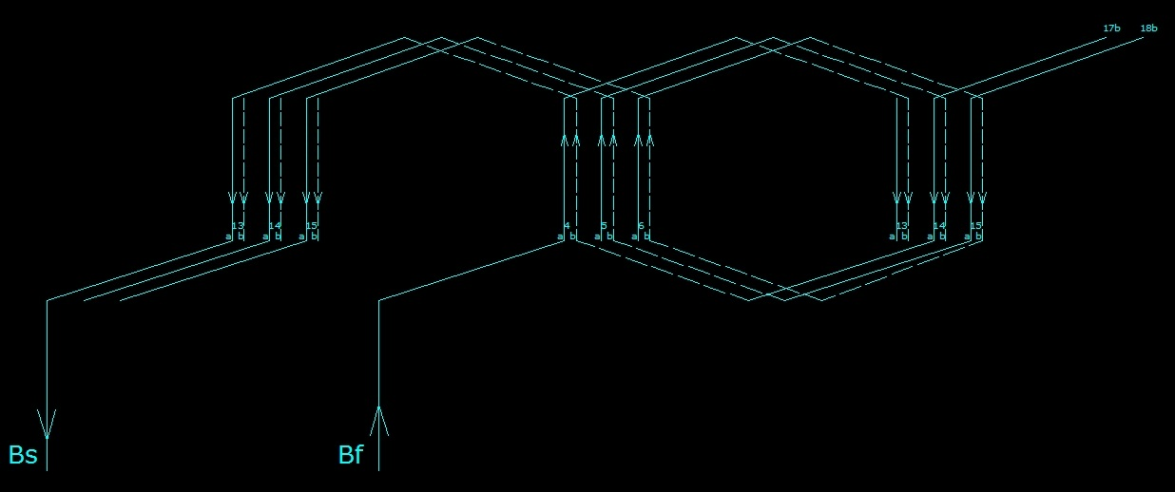
13 | 13’
4 | 4’ | 14 | 14’
13 | 13’ | 5 | 5’ | 15 | 15’
 |  | 14 | 14’ | 6 | 6’
 |  |  |  | 15 | 15’
Note: 1a means 1, top of 1. 1b means 1’, bottom of 1

Slide 18
Slot pole table
Yellow
 | Red | Blue | Yellow
Pole 1 – N | 1 2 3 | 4 5 6 | 7 8 9
Pole 2 – S | 10 11 12 | 13 14 15 | 16 17 18
7 | 7’
16 | 16’ | 8 | 8’
7 | 7’ | 17 | 17’ | 9 | 9’
 |  | 8 | 8’ | 18 | 18’
 |  |  |  | 9 | 9’

Slide 19
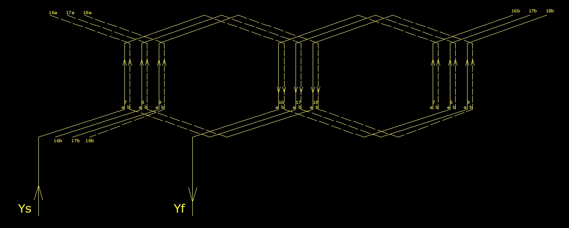
7 | 7’
16 | 16’ | 8 | 8’
7 | 7’ | 17 | 17’ | 9 | 9’
 |  | 8 | 8’ | 18 | 18’
 |  |  |  | 9 | 9’

Slide 20
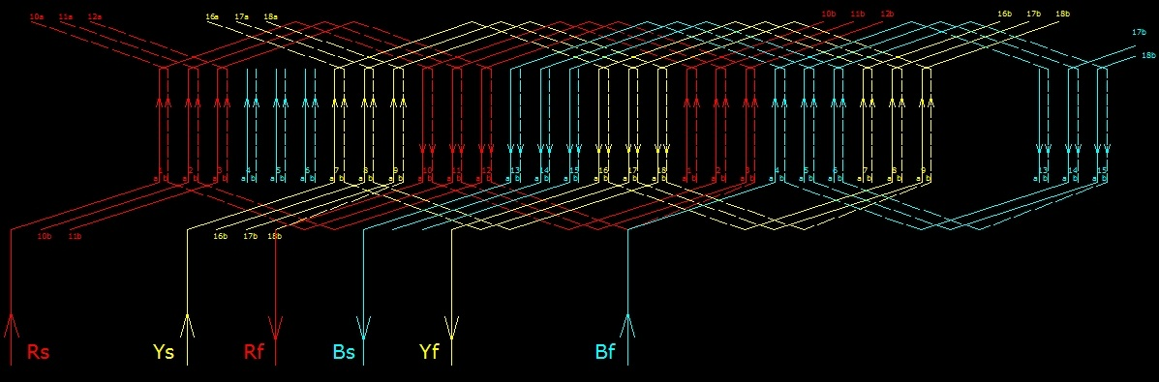
The complete winding
Note: To draw wave winding, it is always better to draw extra slots from 1 after the last slots to get continuity In the connections. Here, after 18 18’, slots have been repeated from 1 1’

Slide 21
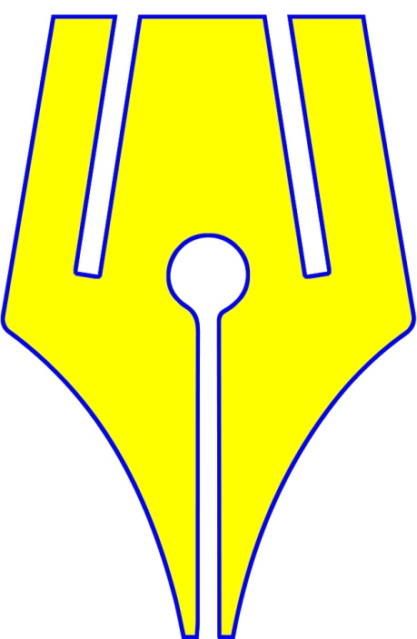
https://www.riteach.com

